Slide 1
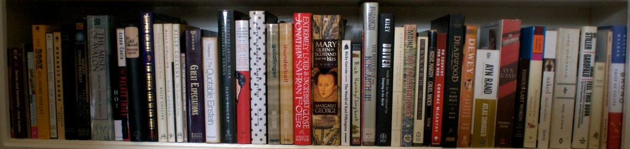

JSRCC Library
image from Flickr User eloquentlight's photostream
Your First Stop for Information and Research Needs
http://library.reynolds.edu

Slide 2
Library Resources
Books
Periodicals
Videos
Audio Books
Print: 90,000
Online: 40,000
Print: 400
Online: 50,000
DVDs: 3250
Online: 1046
Disc: 694
Databases: 200
Online: 8750
Other Collections:
ESL
Career
Juvenile
Educational & Popular
Notes:
Image Credit:
Books: http://www.flickr.com/photos/leff/543016844/
Periodicals: http://www.flickr.com/photos/hectoralejandro/3967217852/
DVDs: http://www.flickr.com/photos/several_bees/331274728/

Slide 3

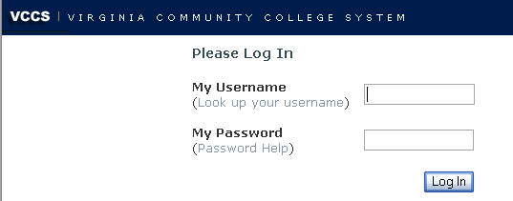
Off-Campus Access to Library Databases
When you click on any JSRCC Library database link on the library's web site, the VCCS login screen will appear.
Type your My JSRCC login, the same username and password as you use for your Blackboard. You will then be connected to the database.

Slide 4

Borrowing From Other Libraries
Richmond Academic Library Cooperative Promotes resource sharing between the Richmond area’s academic libraries and the library of Virginia by providing reciprocal borrowing privileges to students and faculty.
Interlibrary Loan Service that allows JSRCC Libraries to borrow materials from other libraries around the world.
Notes:
Image Credit: http://www.flickr.com/photos/ooohoooh/1350774047/

Slide 5

Research Help
Information Literacy Sessions
Online Course, Subject & Research Guides
Library Workshops - A variety of research workshops are offered during the year.
One-on-one Research Consultations
Ask a Librarian - Drop by the Reference Desk, e-mail us, call us or chat with us.

